Slide 1
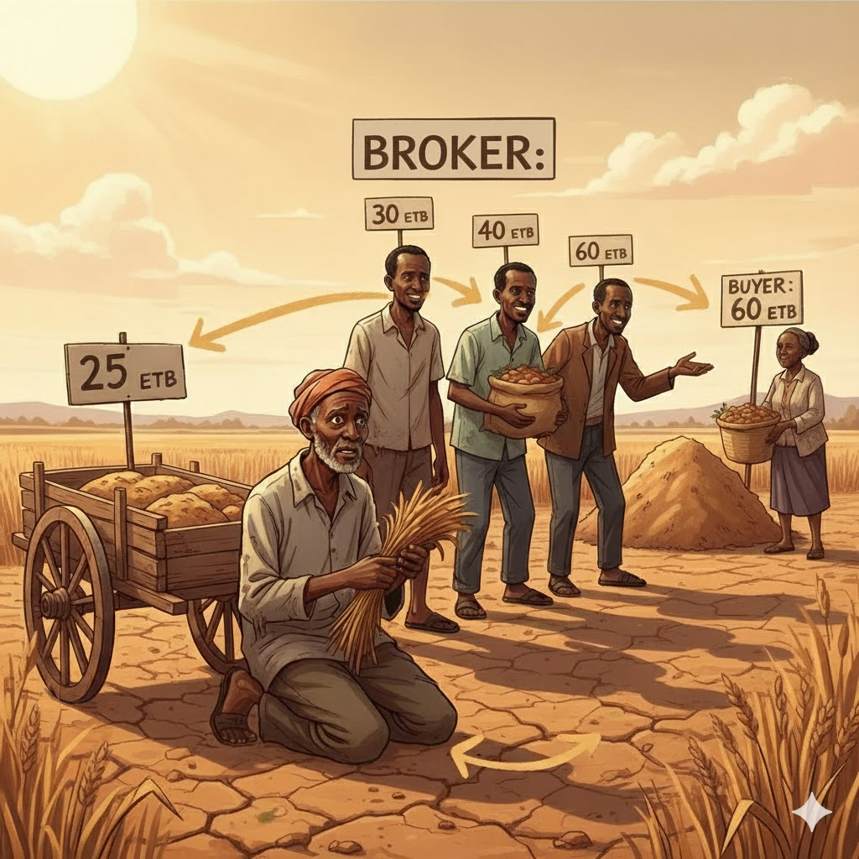
Ethiopian farmers lose up to 70% of potential income due to multiple middlemen sometimes 3 to 6 brokers between farm and market.
❌ Farmers earn less.
❌ Buyers pay more.
❌ Markets lack transparency and trust.

Slide 2
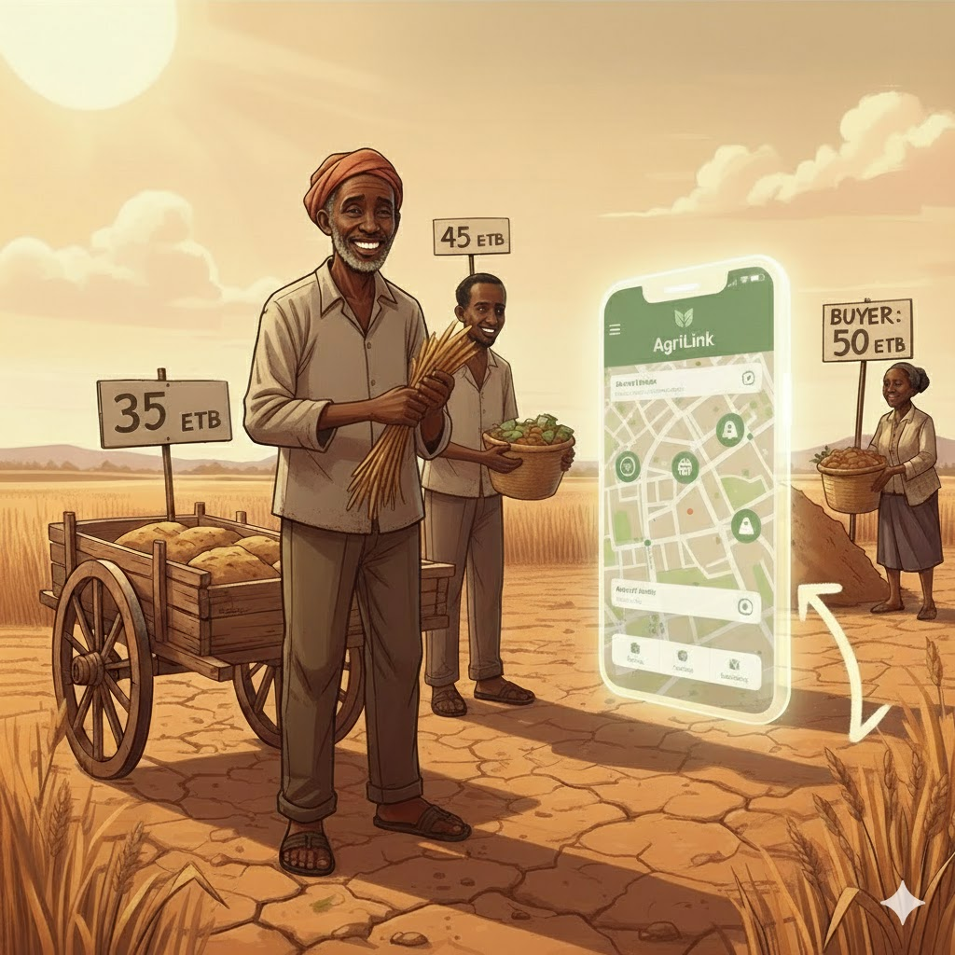
“Introducing AgriLink P2P Marketplace a digital trading platform where farmers, brokers, and buyers connect directly with transparent, fair pricing.”
Farmers post what they produce and set their own price with AI price recommendation.
Brokers can buy in bulk and resell with visible commission.
Brokers get Trust Score-based loans to scale their business.
Buyers purchase directly from farmers or brokers.
All payments and deliveries happen securely in-app.

Slide 3
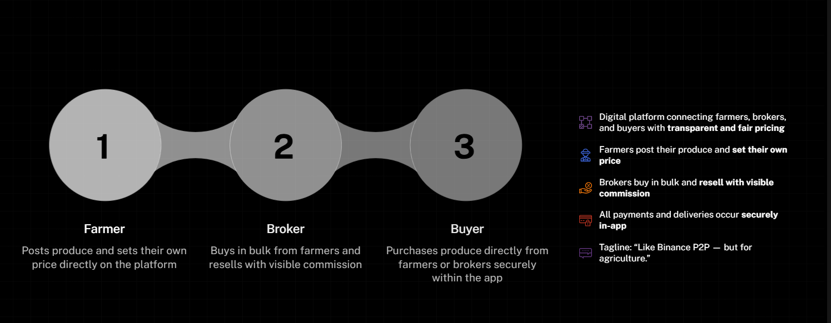
Innovation & Value Proposition

Slide 4
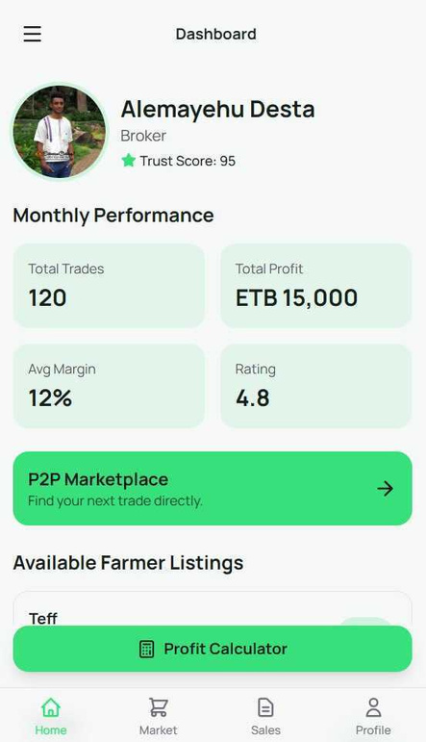
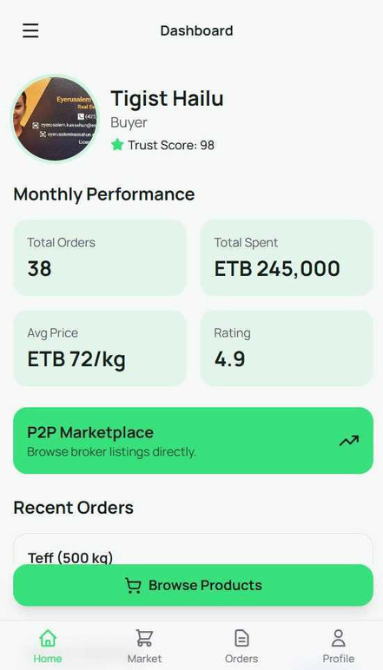
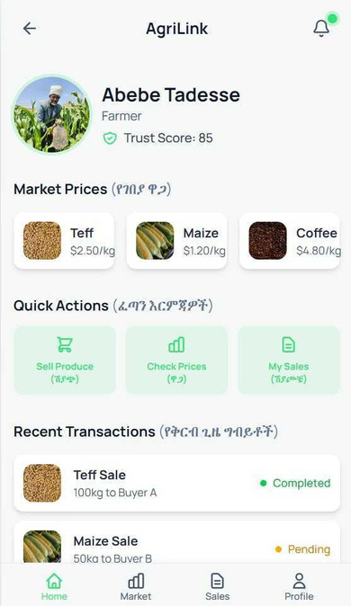
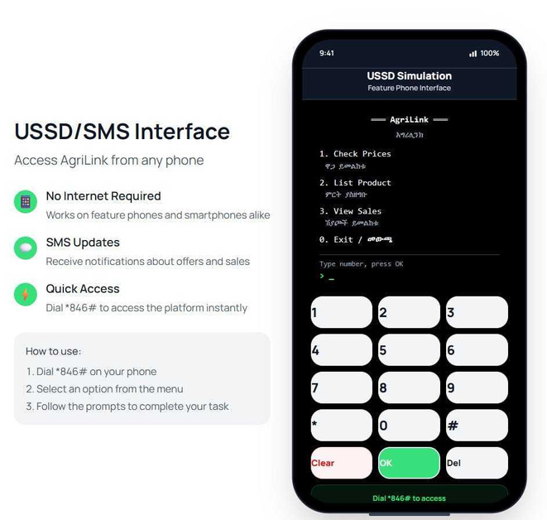
Our products are tailored for all users according to their roles — this is how we aim to solve the problem
Web and app for the brokers
Web and app for the Buyer
Web and app for farmers those with internet access and awareness.
USSD for farmers without internet

Slide 5
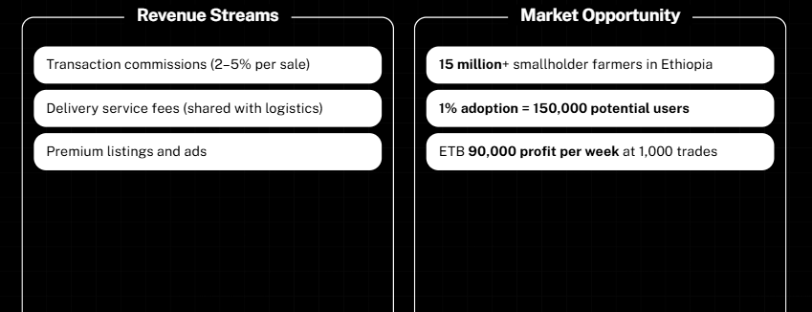
Unlocking Revenue and Market Potential in Ethiopia
Empowering Smallholder Farmers Through Innovative Business Models

Slide 6
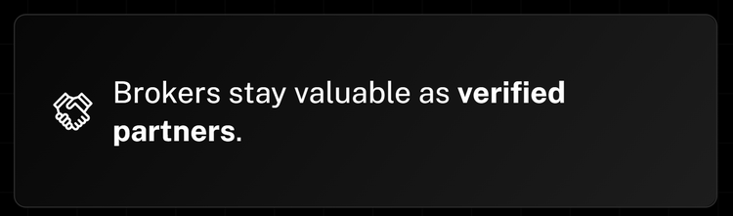
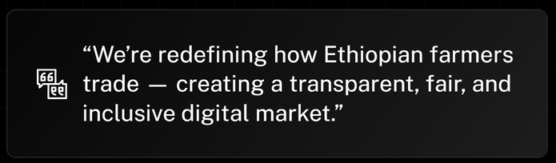
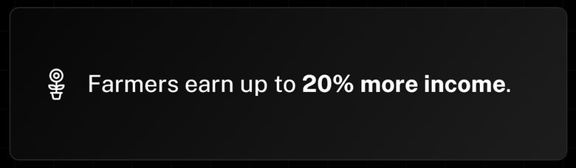
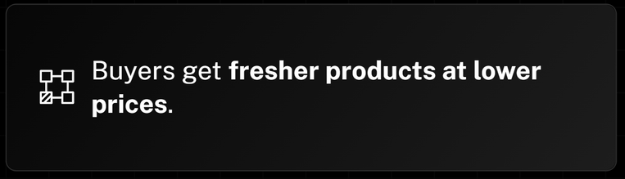
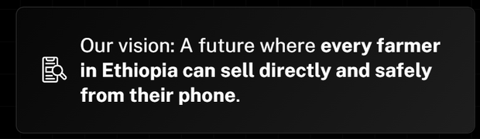
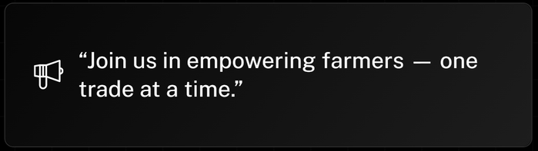
Redefining Trade for Ethiopian Farmers
Creating a fair, transparent, and inclusive digital marketplace

Slide 7
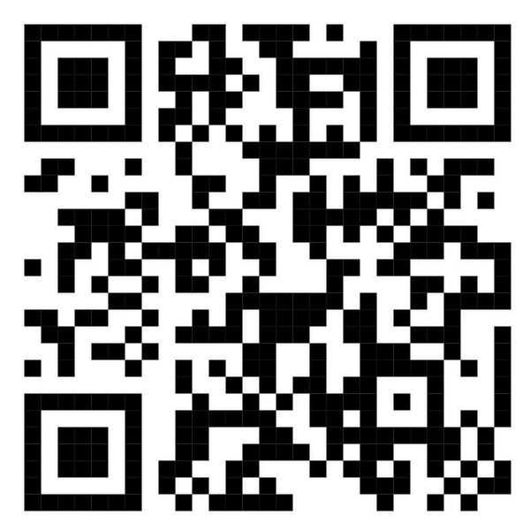
THANK YOU
To view our responsive app, please scan the QR code or click the link below.
https://q.me-qr.com/MVOWDWEP

